Slide 1
Mini Project 1 Demo
Jacob Lazda - 40041526

Slide 2
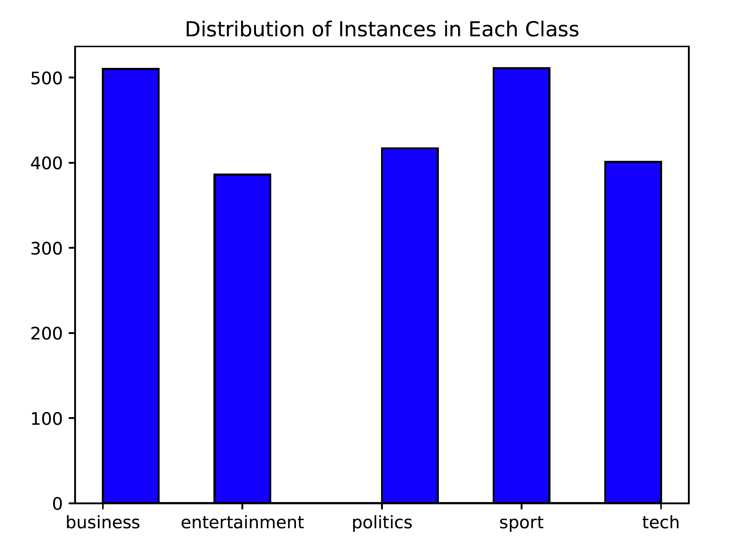
Task 1 - BBC Dataset
Sport and business contain the most documents with (511 and 510)
The other 3 classes have about 100 less documents
This will be reflected in the priors of the training set and it will have an influence on the probabilities of the classes in the test set
Given any test document, it will have a higher probability of being of class business or sport
Given the nature of this dataset, we will value precision over recall

Slide 3
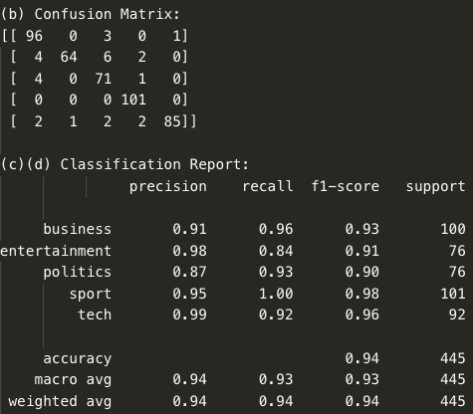
Multinomial NB - Default (Tries 1 & 2)
Exact same results each time, likely due to the fact that we are not splitting the dataset again
The model is trained on the same data and tested on the same test set both times
100% recall in the sport class, and the sport class had the highest prior probability (23%)
Lowest recall in entertainment, entertainment had the second lowest prior probability (17.4%) and had the lowest token count of all the classes (100606)

Slide 4
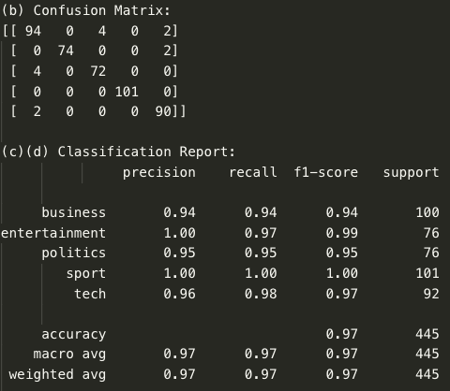
Multinomial NB - Smoothing: 0.0001
Much less confusion of classes compared to the default
Achieves 100% F1-score in the sport class and 100% precision in the entertainment class
The 0.0001 smoothing helps eliminate any issues when there are tokens with a frequency of 0 in the class.
About 16000-17000 words with frequency 0 in each class!
The small smoothing value reduces the error and leads to much better average scores

Slide 5
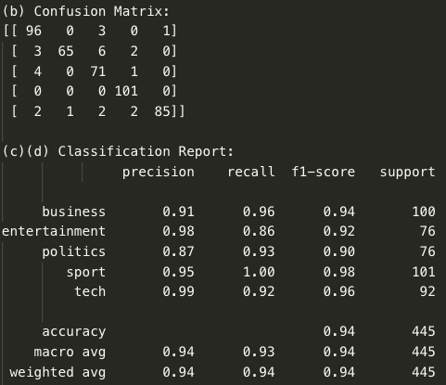
Multinomial NB - Smoothing: 0.9
Oversmoothing
Average scores drop to almost the same levels as the default NB classifiers
The value 0.9 is too large, since the number of words in the vocabulary is quite large (26950) the denominator of the word probabilities will increase by almost double.
26950 + 0.9x26950 = 51205
This large value hinders the performance of the NB classifier
Compared to 26952.695 from the previous classifier

Slide 6
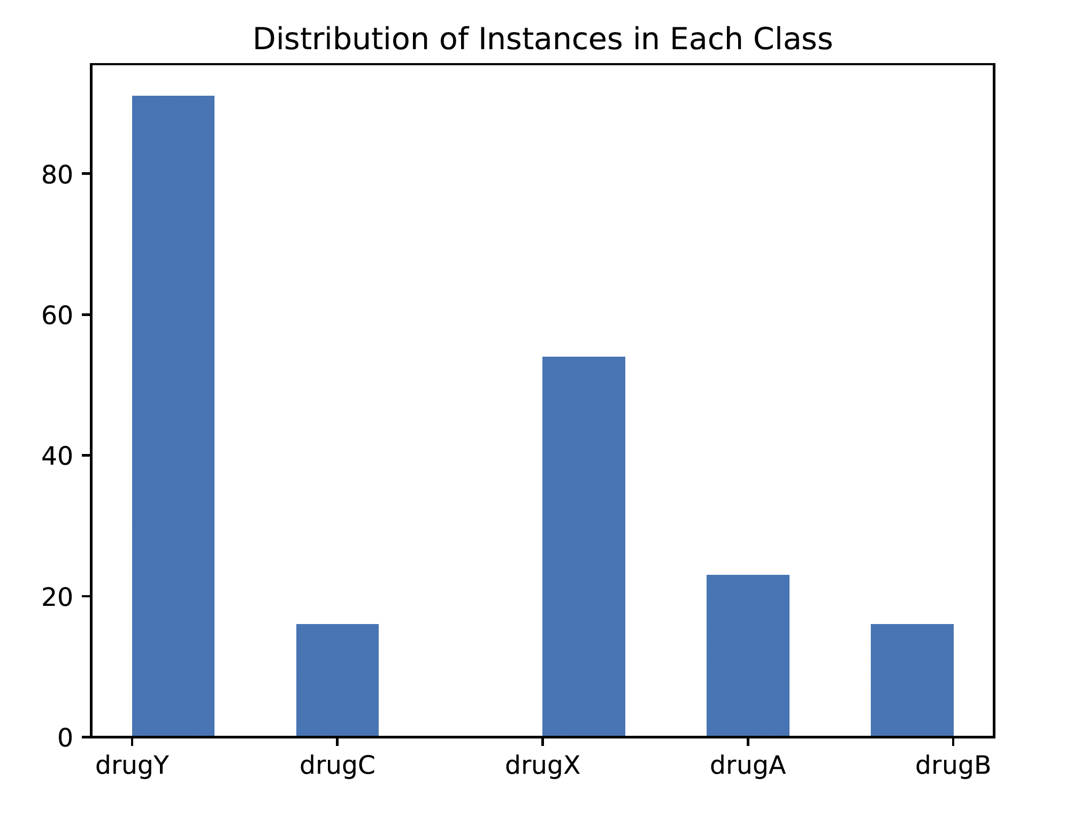
Task 2 - Drug Dataset
Drug Y takes up a very large portion of the dataset. Drug X has a bit more than half of the data as Y.
Drugs A, B and C are all much more rare
This will likely cause some issues with the classifiers since the priors of X and Y will be a lot higher than those of A, B and C

Slide 7
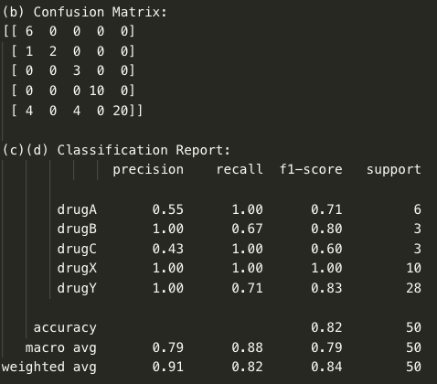
Gaussian NB Classifier
Training set consists of 150 instances and test set contains 50
100% precision for drugs B, X and Y
100% recall for drugs A, C and X
As expected, tradeoff between recall and precision in all drugs, except for X
All in all, not a great macro average and accuracy
Much smaller sample sizes compared to the text classification

Slide 8
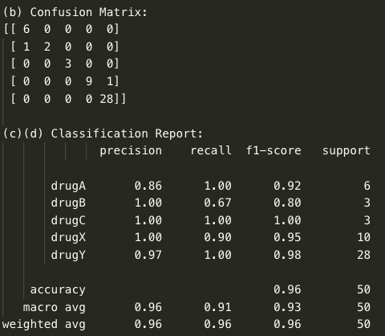
Base Decision Tree Classifier
Decision Tree is much more accurate than the Gaussian NB classifier
Likely due to the fact that there are not too many features, leading to a relatively short tree
Only 5 features, likely have high information gain after splitting the data on each one of them, given the accurate results
Drug C has a 100% F1-score but only has 3 samples in it. Likely a result of the small sample size

Slide 9
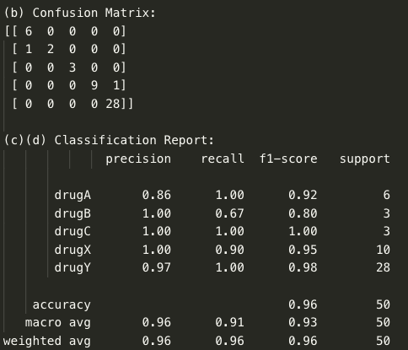
Top Decision Tree Classifier
Best hyper-params:
Criterion: gini - uses the Gini impurity to measure the quality of the split rather than entropy and information gain
Max_depth: 5 (choice between 3 and 5), 5 leads to all the features being used, 3 would ignore some
Min_samples_split: 5 (choice between 5, 11, 19) small enough sample size that it doesn’t need many samples to decide whether or not to split the tree

Slide 10
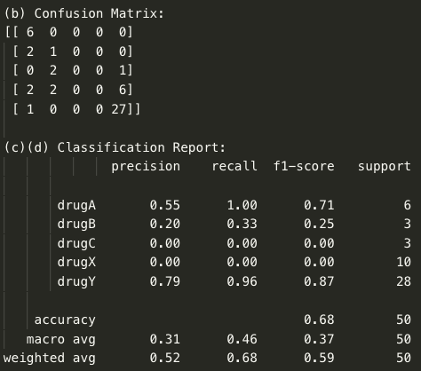
Perceptron Classifier
As one would expect, the Perceptron does not perform well at all due to their being 5 classes
It splits each test data into one of 3 classes as seen in the confusion matrix
Results in a very poor macro average for both precision and recall
A single Perceptron is not the right classifier for this job

Slide 11
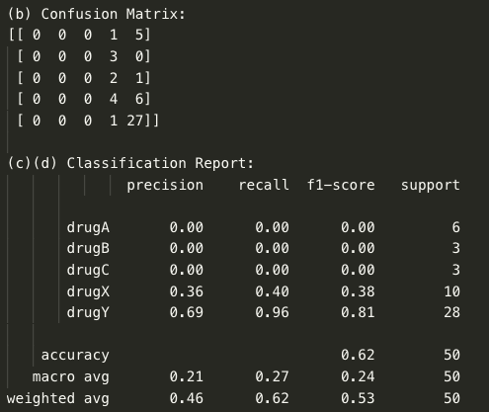
Base ML Perceptron Classifier
Similar issue compare to the single Perceptron
Only divides the data into drug X or drug Y, likely because they are the two most prevalent classes
Results in a low macro average (even lower than for a single Perceptron!)
Only good for recall of drug Y, since most of the drugs in the sample are drug Y anyways.
Modified parameters:
Hidden_layer_sizes = 100
Activation = logistic
Solver = sgd

Slide 12
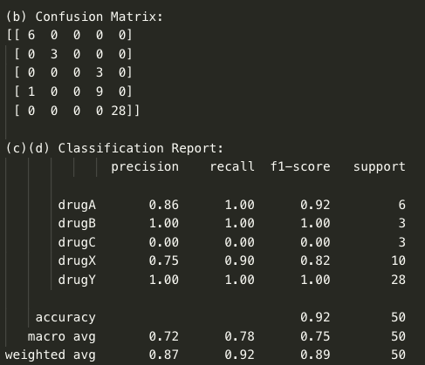
Top ML Perceptron Classifier
Best hyper parameters:
Activation = tanh
Hidden_layer_sizes = (30, 50)
Solver = adam
With these parameters, the model is able to classify the drugs into 4 classes instead of just 2 or 3 compared to the other 2 Perceptron models
Likely the hidden_layer_size = 100 was too large
Macro average is still lower than the first models, but it they are the highest of the Perceptron models

Slide 13
Running Models 10x
Gaussian NB, both decision trees, and the lone Perceptron are the same every time -> std dev = 0 or very close to 0 (1e-16) for accuracy, macro F1 and weighted F1
This tiny number is likely due to rounding errors in the computer, so the std dev can be assumed to be 0
The Base MLP and Top MLP change every time. Std dev for Base MLP is around 0.07 for the three stats and is around 0.03 for the three stats for the Top MLP
This is due to the fact that the MLP are unable to converge in time. It would take far too long and would require a lot of CPU for these models to converge so there will be differences between each run
From the results, both decision trees are clearly the best models for this type of data, posting average accuracies of 0.98, macro F1s of 0.99 and weighted F1s of 0.98.
The single Perceptron is the worst in terms of classifying the drugs into 5 categories

